Slide 1
Fertilizer
Applicator Training
May 9, 2014

Slide 2


Fertilizer Use Act of 2011
Maryland’s Lawn Fertilizer Law

Slide 3
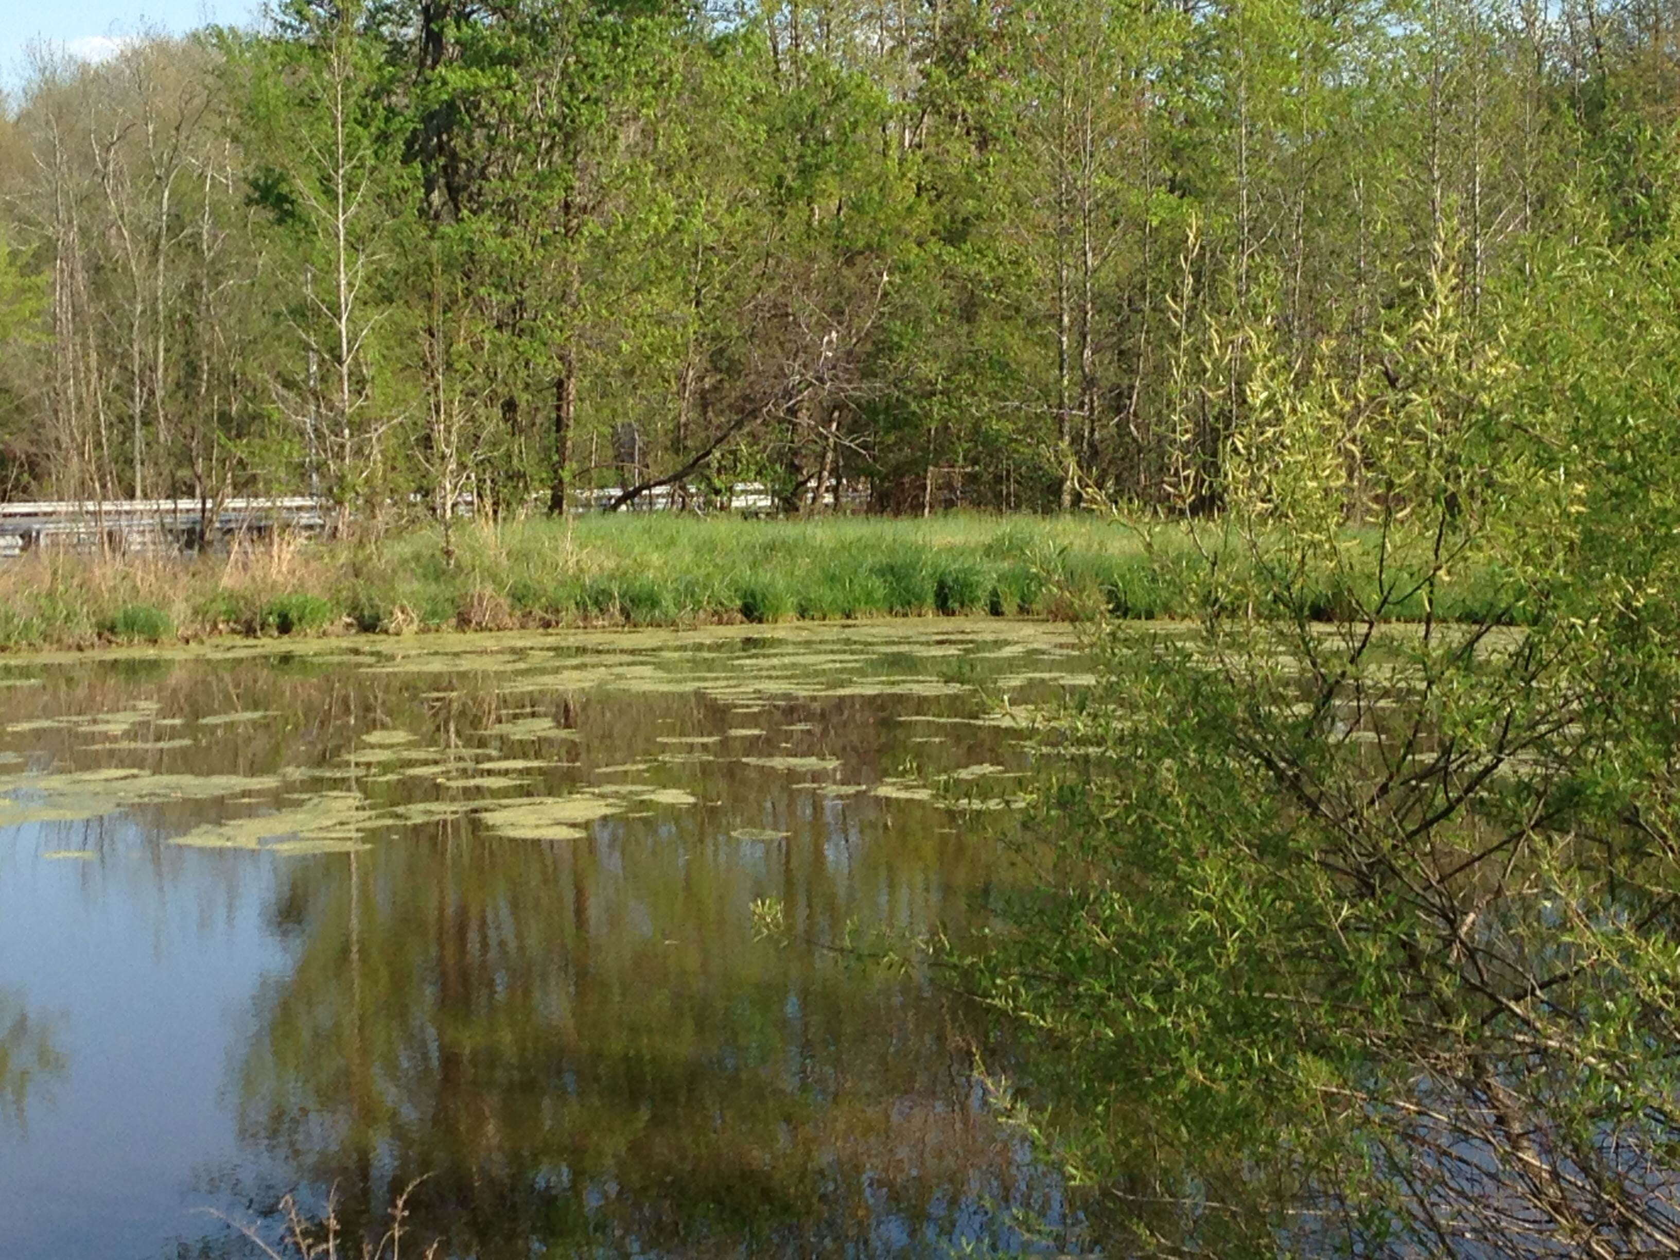
Fertilizer that’s good for turf can be bad for the water.

Slide 4
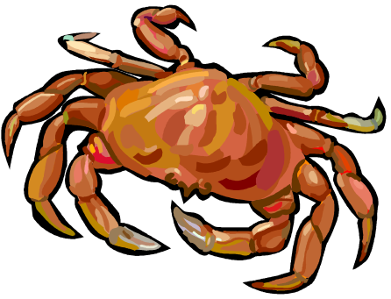
Fertilizer Risk
Nitrogen & phosphorus are primary parts of fertilizer.
When nitrogen & phosphorus get in the water, they cause excessive algae growth
As the algae die and decompose, they use up the oxygen in the water
This leads to “dead zones” in the Bay
Without oxygen, fish, crabs, and other aquatic creatures die, too.

Slide 5
Fertilizer Risk cont’d
To comply with the Clean Water Act, Maryland and other nearby states are required to reduce the amount of nitrogen and phosphorus entering the Chesapeake Bay.
The new fertilizer law was designed to keep fertilizer out of the water.

Slide 6
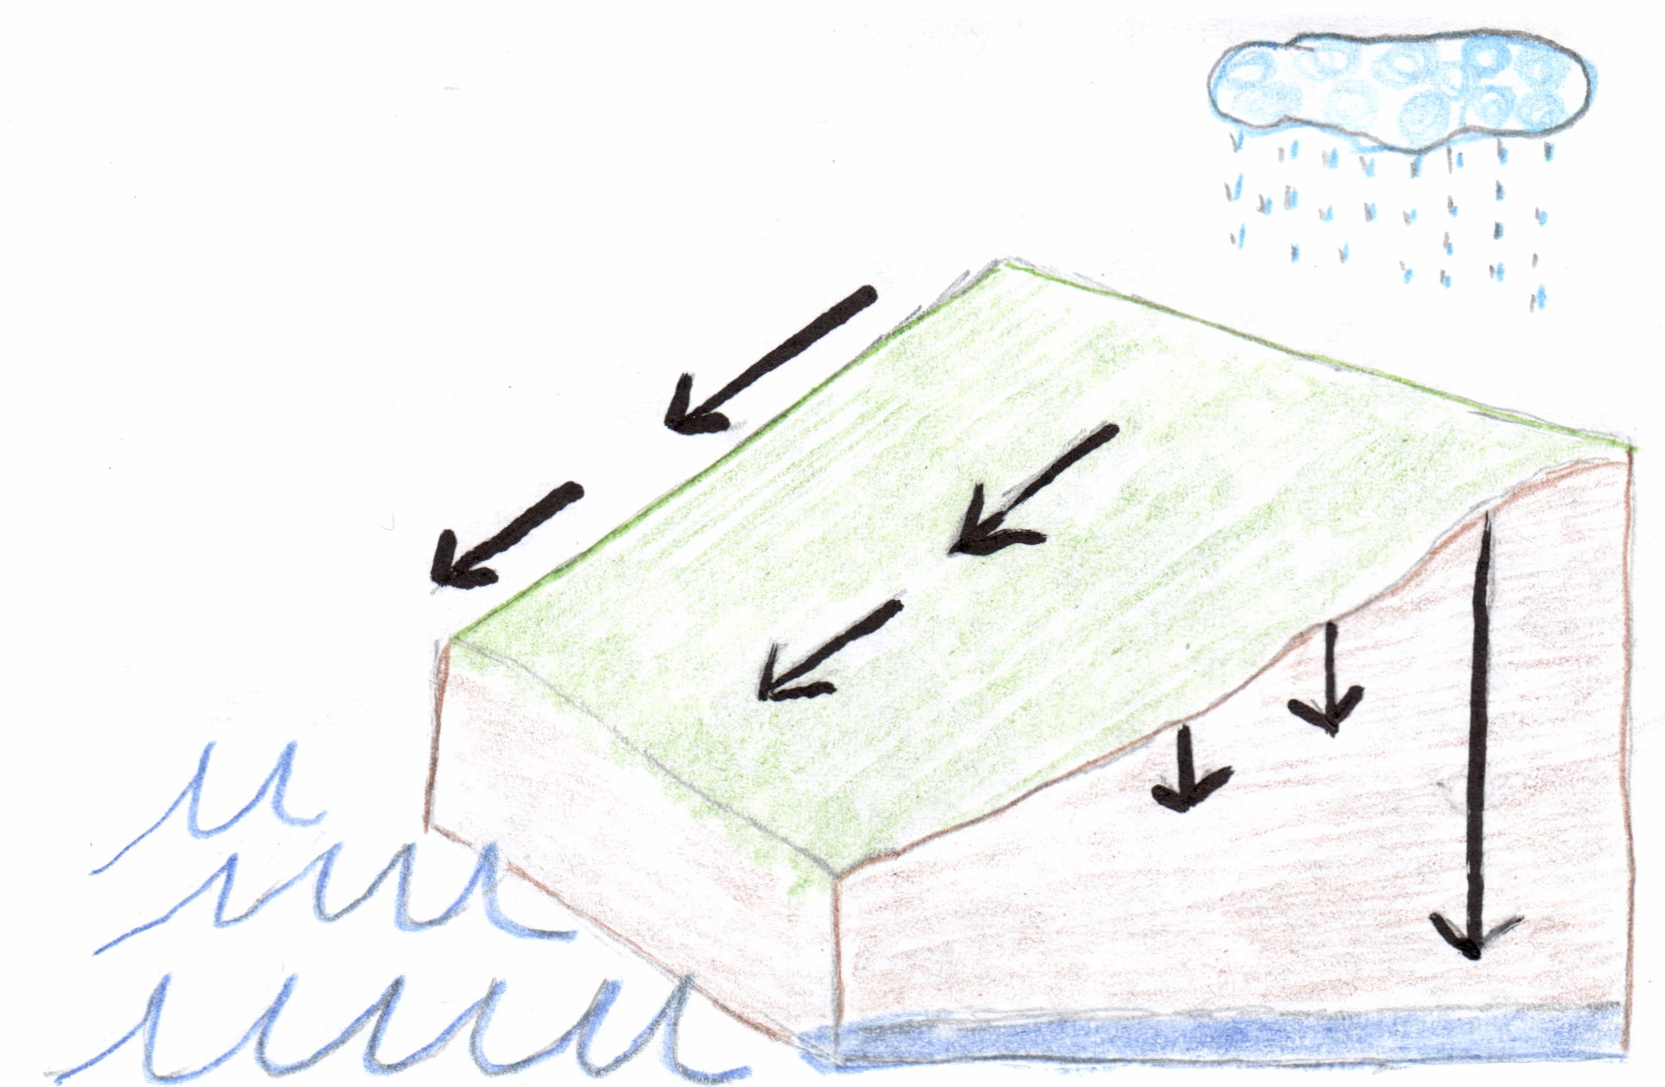

There are two ways for nutrients to get into the water:
leach down through the soil or
wash off the surface, either alone or with eroded soil
runoff
Leaching to groundwater

Slide 7

Certification is Required
To ensure that paid fertilizer applicators apply fertilizer correctly, they must be certified, or work under the direct supervision of someone who is.
A person must pass a test to become a Certified Professional Fertilizer Applicator (CPFA).

Slide 8
Nutrient Needs of Turf
Grass, like all plants, needs 16 nutrients for growth.
These nutrients come from the air, water, and mostly from the soil.
Fertilizers supplement the nutrients in the soil. The nutrients typically included in fertilizers are:
Nitrogen
Phosphorus
Potassium
These are the nutrients that plants use in the largest amounts.

Slide 9
A Little Bit About Grass

Slide 10

Kinds of Grass
There are many kinds of grass that grow in Maryland, but only a few that are suitable for home lawns.
These can be divided into cool season and warm season grasses.

Slide 11

Kinds of Grass cont’d
Cool season grasses grow best in the early spring and the fall. In the heat of the summer, they grow very slowly and may turn straw-colored.
Warm season grasses grow well in the hot summer, but turn straw-colored after the first frost.

Slide 12
Fertilize at the Right Time
Grass should be fertilized when it is actively growing so the roots will take up the fertilizer.
This decreases the risk that the fertilizer will leach down through the soil and into the groundwater.
Fertilize warm season grasses after dormancy breaks through the end of August.

Slide 13
Fertilize at the Right Time cont’d
Fertilization of cool season grasses is a little more complicated.
Fertilizer applied in the spring causes rapid top-growth.
Fertilizer applied in the fall grows and strengthens the roots.
Most of the total annual amount of fertilizer should be applied to cool season grass in the fall.

Slide 14
Soil Testing

Slide 15
Why Soil Test?
It is the only way to accurately determine nutrient needs of turf.
To determine pH (or acidity) of the soil.
It helps to diagnose problems.
It is required in order to apply phosphorus.
A soil test is valid for three years

Slide 16
pH
Is a measure of the level of acidity in soil
Scale of 1to 14
If pH is too high, or too low, nutrients in the soil will not be available for uptake by the plant.
Low pH is corrected with lime, high pH is corrected by sulfur.
Ideal pH for turf is slightly acidic, or less than 7.

Slide 17
Proper Soil Testing
A Management Unit is the land area that can be covered by a single soil sample.
The area should:
Have similar soil types and fertility levels
Have been managed the same in the past
Be managed the same in the future

Slide 18
Proper Soil Testing cont’d
Take a separate soil sample for:
Unusual or different soil conditions
  Wetter or dryer
  Imported fill, topsoil, or organic matter
Shade vs. sun
Poor plant performance
These should be a different management unit

Slide 19

Proper Soil Testing cont’d 2
The accuracy of a soil test depends largely on the quality of the soil sample submitted.
Walk the grounds
Interview the homeowner
  Ask about problems
  Learn about any past treatments and results

Slide 20

Soil Sampling
Sample to depth of 3-4 inches for turf
Use a soil probe or spade
Collect 12-15 subsamples from each management unit, covering the area in a zigzag or W shaped pattern
Avoid areas that are obviously different, such as a patch of dead grass or a low spot
Remove surface litter, stones, roots and debris

Slide 21
Soil Sampling cont’d
Mix together in a plastic bucket.
Mix the subsamples thoroughly, because only a very small amount of the soil will actually be tested.
Air dry the samples, do not heat in an oven.
Send about 1 cup of soil to the lab.
Use an approved lab listed in Appendix C of Maryland’s Professional Lawn Care Manual.

Slide 22

Measuring Area

Slide 23

Measuring Area
To determine how much fertilizer is needed, you must know the size of the property.
Applying the correct amount of fertilizer helps the grass to grow without leaving excess fertilizer to runoff or leach.

Slide 24

Measuring Area cont’d
The CPFA or an estimator will normally measure the property and determine how much fertilizer is needed.
Be alert for changes that might affect how much fertilizer is needed.
Has the homeowner reduced the turf area by adding a garden? Be sure to notify your supervisor.

Slide 25

Measuring Area cont’d 2
There are several computer programs that enable you to measure an area remotely
Sometimes, a good old-fashioned measuring wheel is used.
Measure the entire property and subtract the areas that don’t get fertilizer. The remainder is the fertilized area.

Slide 26
Break oddly shaped properties into simple shapes
House
driveway
garden

Slide 27
Here’s a Rectangle

Slide 28
Here’s a Triangle

Slide 29
Here’s Half of a Circle

Slide 30
Here’s Rectangle B

Slide 31
Measuring Area- rectangle
Rectangle Area = Length x Width

Slide 32
Measuring Area- triangle
Triangle Area = ½ base x height
height
base

Slide 33
Measuring Area- circle
  Circle area = 3.14 x radius x radius
radius

Slide 34

Add together the parts to get total area of the property:
Rectangle A
+ Triangle #1
=Area of Property

Slide 35
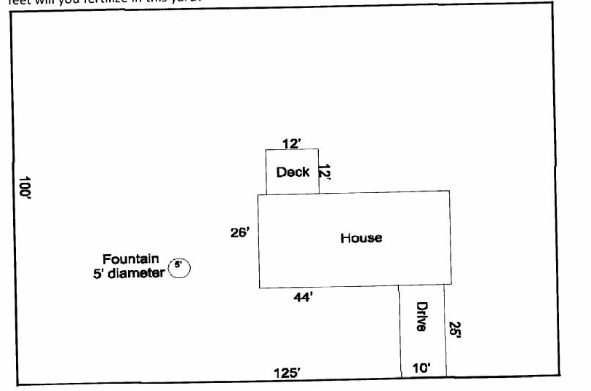
Subtract areas not fertilized

Slide 36
To get the fertilized area:
Rectangle A
+ Triangle
- House (Rectangle B)
- Driveway (1/2 of Circle)
=Area Fertilized

Slide 37
Equipment Calibration

Slide 38
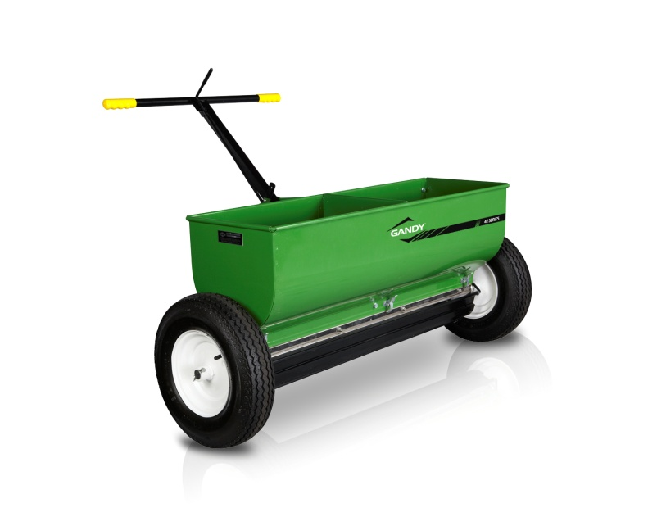
Equipment Calibration cont’d
The CPFA is responsible for ensuring that spreaders are properly calibrated.
Most professional-grade products come with suggested spreader settings.
Spreaders must be calibrated to ensure these settings are correct.

Slide 39

Equipment Calibration continued
The goal of calibration is to determine how much fertilizer is being applied per unit area, or the application rate.
There are two factors that affect the fertilizer application rate, the spreader setting, and the applicator’s walking speed.

Slide 40
Equipment Calibration- granular fertilizer
Both broadcast and drop spreaders operate using gravity. Gravity causes the fertilizer granules to drop from the hopper.
The setting controls how fast the fertilizer granules drop from the hopper.
Fertilizer granules drop at the same speed, regardless of whether the applicator is running or standing still.

Slide 41

Equipment Calibration
Changing walking speed changes the fertilizer application rate.
The applicator must maintain the same speed all day, every day.
Practice walking using a watch with a second hand, a metronome or a song with a steady beat.

Slide 42
Field Adjustments
Check the total amount of fertilizer applied after half a day. Does the amount applied match what should have been applied based on property size?
If not, and your walking speed has not changed, you may need to adjust the setting up or down slightly.
The CPFA should provide guidance for field adjustments.

Slide 43
Field Adjustments cont’d
As equipment wears, the setting may need to be adjusted.
Changes may be temporary. High humidity can cause fertilizer pellets to stick together.
If you have adjusted the setting to compensate for humidity, remember to change back the next day.

Slide 44
Spreader Calibration
Spreaders should be calibrated at least annually and whenever something changes, for example, changing from lime to fertilizer.
If equipment or parts are changed, the spreader should be re-calibrated.

Slide 45
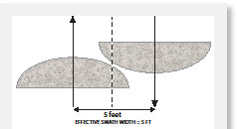
Spreader Calibration cont’d
The CPFA will determine the swath width and instruct you on how far apart each successive pass should be.

Slide 46
Hose & Gun Sprayer Calibration
The CPFA is responsible for selecting the correct nozzle and calibrating the hose & gun sprayer.
As with a drop spreader or a broadcast spreader, pace is critical. The trained applicator should practice pace on a training course set up by the CPFA

Slide 47
Hose & Gun Sprayer Calibration cont’d
Check the flow rate each day to make sure it has not changed.
If your supervisor does not perform this task, he or she should instruct you how to perform a bucket check following the procedures in the Maryland Professional Lawn Care Manual.

Slide 48

Check your equipment
Inspect your equipment daily to ensure that it continues to operate properly.
Clean equipment as needed to prevent blocked openings and ensure the impeller spins freely.

Slide 49
Reading a Fertilizer Label

Slide 50
How to read a fertilizer label
Looking at a bag of fertilizer, you will see 3 numbers, for example: 22-0-10
These three numbers tell you the percent by weight of the 3 most important fertilizer ingredients:
% Total Nitrogen (N), % Available Phosphate (P₂O₅), and soluble Potash (K₂O)
Note that by convention in the fertilizer industry, the numbers do not indicate elemental phosphorus (P) or potassium (K).

Slide 51
22-0-10
The numbers on the fertilizer bag are always listed in the same order: N-P₂O₅-K₂O
This fertilizer contains 22% nitrogen and 10% potash (K₂O), but no phosphate (P₂O₅)
To determine how much of a nutrient is contained in a bag of fertilizer, multiply the weight of the bag by the percent of the nutrient, expressed as a decimal.
A 50 lb bag of 22-0-10 would contain (50 X 0.22) or 11 lbs of N, and (50 X 0.10) or 5 lbs of K₂O.

Slide 52
Some Bags Have 4 Numbers
  10-0-7-2
The 4th number can be anything except nitrogen, phosphorus, or potassium.
Read the label to find out what it is.

Slide 53
Forms of Nitrogen
  There are 2 main forms of nitrogen that may be contained in the fertilizer.
  Quick release or water soluble nitrogen (WSN)
  Slow release, controlled-release, or water insoluble nitrogen (WIN)
  The law limits how much soluble nitrogen and how much total nitrogen may be applied

Slide 54
Forms of Nitrogen cont’d
Quick release nitrogen is immediately available for uptake by the grass. It is also more likely to leach into the groundwater.
Slow release nitrogen provides a continuous supply of nitrogen to the grass over an extended period of time. It won’t, however, cause the grass to immediately green up.
The ideal turf fertilizer contains a combination of quick release and slow release nitrogen.

Slide 55
Provisions of the Lawn Fertilizer Law

Slide 56
Nitrogen Limits
A single fertilizer application may contain no more than 0.7 lb/1000 sq ft of soluble nitrogen and no more than 0.9 lb/1000 of total nitrogen.
The annual amount of nitrogen applied is limited to the amount recommended by the University of Maryland Extension, and depends on the type of grass being fertilized and the use of the area.

Slide 57
Phosphorus Limits
Fertilizer applied to turf may not contain phosphorus unless:
A soil test, that is not more than 3 years old, indicates there is a need; or
Turf is being established or re-established and the ground has been tilled, or otherwise disturbed, such as with construction; or
A lawn patch product is used (seed, fertilizer, and mulch combination).

Slide 58
The Certified Professional Fertilizer Applicator is responsible for selecting the appropriate fertilizer and determining the application rate.

Slide 59
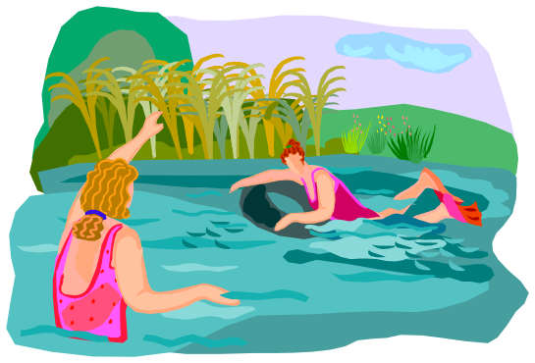
Stay away from water!
Nitrogen and phosphorus cannot be applied to turf within 15 feet of water.
If the application is made with a drop spreader, a broadcast spreader with a deflector shield, or a targeted spray, the buffer can be reduced to 10 feet.

Slide 60
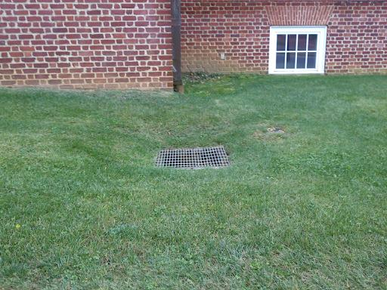
This is water, too!

Slide 61
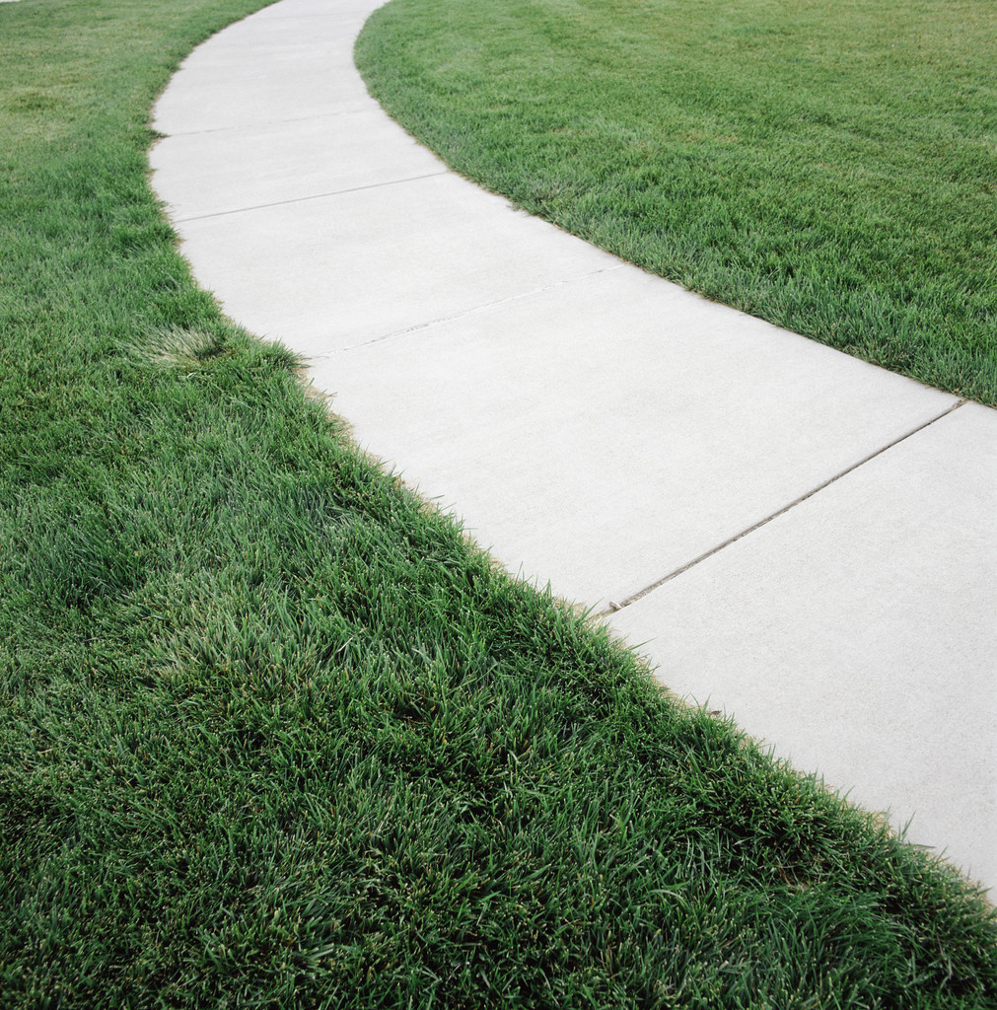
Do not apply before or during a heavy rain, or when the ground is frozen.
Do not apply to impervious surfaces.
Fertilizer that lands on impervious surfaces must be swept or blown back onto the turf.

Slide 62


Timing
Do not apply nitrogen or phosphorus to turf before March 1st or after December 1st.
From November 16 until December 1st, no more than 0.5 lbs of soluble or insoluble nitrogen may be applied per 1000 square feet.

Slide 63
Questions?
Call or e-mail the Maryland Department of Agriculture, Nutrient Management Program
410.841.5959
800.492.5590 toll free
Nminfo.mda@maryland.gov

